Slide 1
Signal compression and optimal reconstruction from highly incomplete frequency information using compressive sensing
Title:
Being carried out at Indian Institute of Science
External Guide Internal Guide
Dr. Bhakthavathsalam.R Savitha.G
Senior Scientific Officer Associate Professor
Dept of SERC Dept of CS&E
Indian Institute of Science BNMIT
Bangalore Bangalore
Team Members:
Abhishek Sharma.R 1BG10CS003
Chaitra Suresh 1BG10CS025
Chandan S 1BG10CS026

Slide 2
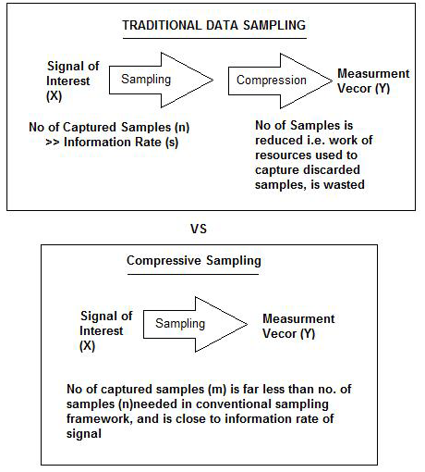
Introduction
The entire signal can be determined accurately from relatively few measurements.
Compressed sensing challenges the traditional sample first-then compress procedure.

Slide 3
Problem statement
To sample a given analog signal at a rate much lower than the Nyquist rate suggested by the Nyquist-Shannon sampling theorem and reconstruct the original signal from highly incomplete frequency information using the compressive sensing technique, also known as compressed sensing, compressive sampling or sparse sampling.

Slide 4
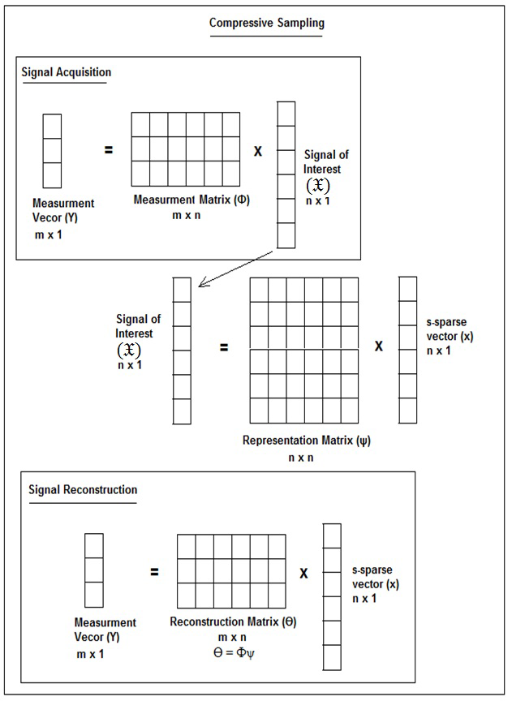
Proposed system
Stage 1
Express input signal as f;
c=Ψ f
Stage 2
Obtain ‘b’ random samples as b=Φf
Stage 4
Reconstruct original signal using l1 magic
Stage 3
Transmit sample file
-1

Slide 5
Implementation
Sampling
Input: Signal to be sampled ‘f’
Basis matrix(Ψ) chosen is Discrete Cosine Transform(DCT).
The vector ‘c’ consisting of major frequency components of the signal is obtained by applying the Inverse DCT(IDCT) to Vector ‘f’
Sampling matrix(Φ) chosen is a subset of rows of an identity matrix.
Random Samples ‘b’ is got by applying Φ to vector ‘c’.
Output: Frequency samples of the input signal ‘b’
Reconstruction
Input: Frequency samples of the input signal ‘b’
Express the problem to be solved in the form ‘Ax=b’ where A= ΦΨ and ‘x’ is the solution to be found. Express this as an optimization problem.
State the primal and dual for the given problem as follows:
Primal problem: Minimize c’ x subject to consrtaints Ax=b where x>=0;
Dual problem: Maximize b’y subject to constraints A’y+s=c where s>=0;
Step 1: Remove inequalities from Primal using Barrier term.
Step 2: State the Lagrange optimality conditions.
Step 3: Apply Newton’s method to the optimality conditions.
Output: Reconstructed signal

Slide 6
Level 0 DFD
1.0
2.0
3.0
Signal generation
Sampling
Reconstruction
Client/User
Sample file

Slide 7
Level 1 DFD
1.1
1.2
Determine frequencies of sinusoids
Generate signal
2.1
Major
components
2.2
Apply basis function matrix
Apply sampling matrix
Client/User
Valid key
Save
samples
3.2
Build non linear optimization problem
3.1
Retrieve values
Sample file
Sample file
Transmit
Write
3.3
Apply primal dual integral point method

Slide 8
Level 2 DFD
Valid
key
Determine frequency of sinusoids
1.1
Generate individual component sinusoids
1.2.1
Combine 2 sinusoids
1.2.2
2.1
Apply basis function
User
Major
components
Apply sampling matrix
3.2
Retrieve values
2.2
Build non linear optimization problem
Sample file
Sample file
Write
to
Transmit
Save
sample
State Lagrange optimality conditions
3.3.3
Apply Newton’s method
Remove inequalities
3.3.4
State primal and dual
3.3.2
3.3.1

Slide 9
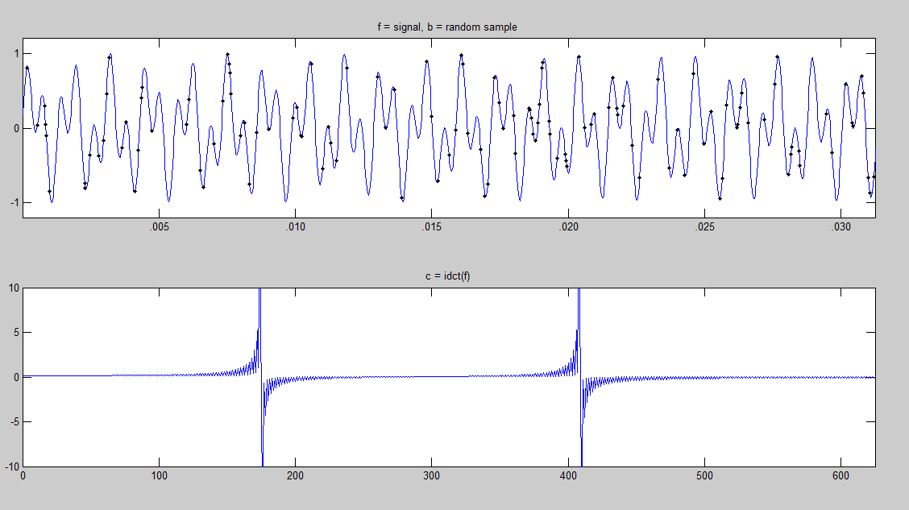
Result
Original signal

Slide 10
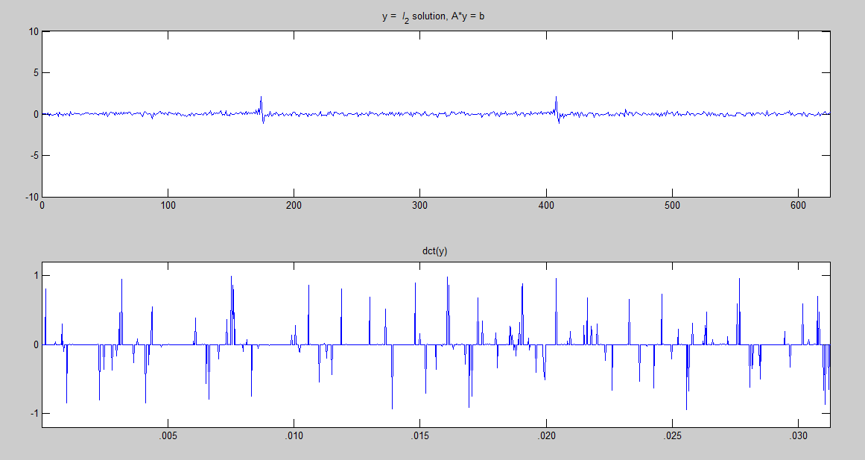
Signal reconstructed by minimizing l2 norm

Slide 11
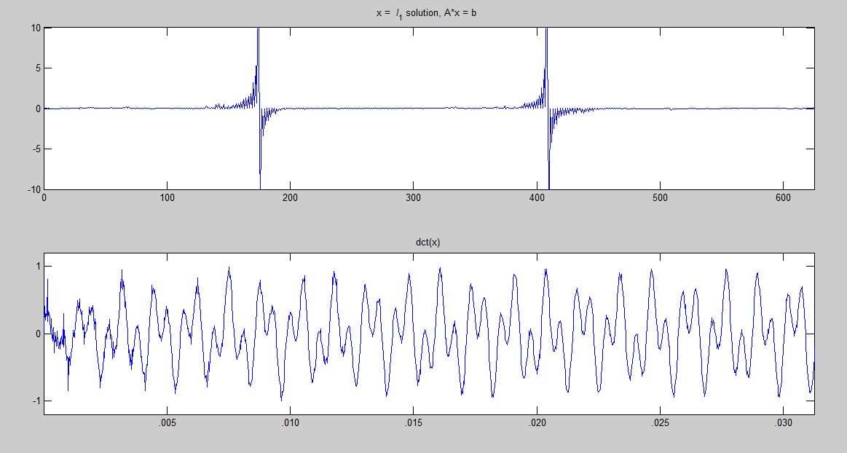
Reconstructed signal by minimizing l1 norm

Slide 13
Conclusion
The mobile keypad touch tone consisting of 2 incommensurate sinusoids was generated, sampled using the compressive sensing technique and reconstructed fairly accurately using relatively few samples(500 as opposed to around 5000 samples, suggested by Nyquist-Shannon theorem).
We will extend the same technique to an audio clip and a comparison between other
reconstruction techniques like Gradient Projection for sparse reconstruction/Matching pursuit and/or its variants may be done by observing the time required, compression achieved and accuracy of reconstructed signal.

Slide 14
References
Saad Qaisar, Wafa Iqbal,Rana Muhammad Bilal, Muqaddas Naureen, Sungyoung Lee, "Compressive Sensing: From Theory to Applications, A Survey", Journal of Communications and Networks, October 2013.
D. Akimura, Y. Kawahara, and T. Asami. “Compressed sensing method for human activity sensing using mobile phone accelerometers”. In International Conference on Networked Sensing Systems (INSS), 2012.
D. Donoho, “Compressed sensing,” IEEE Trans. Inform. Theory, April 2006.
E. CandÃ¨s , J. Romberg and T. Tao "Robust uncertainty principles: Exact signal reconstruction from highly incomplete frequency information", IEEE Trans. Inform. Theory, 2006.
An Introduction To Compressive Sampling Candes, E.J. Wakin, M.B. Signal Processing Magazine, IEEE,2008.

Slide 15
Timeline

